Slide 1
Unit 7-3
Special Right Triangles
PLANE Geometry

Slide 2




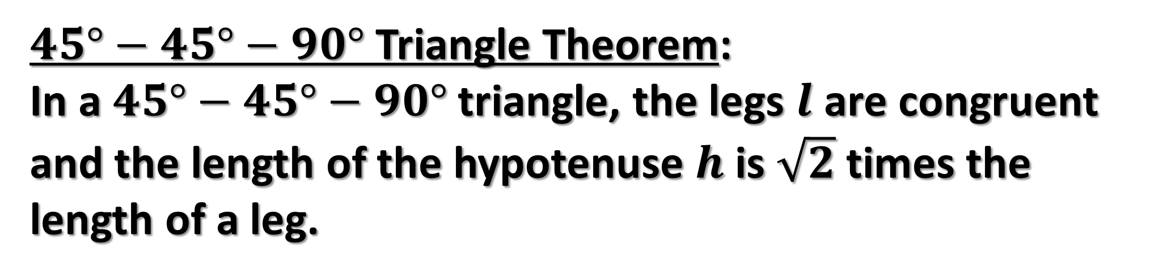
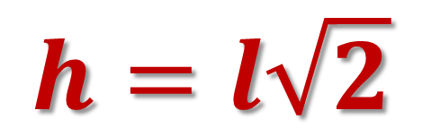
$45°−45°−90°$ Triangle Theorem:
In a $45°−45°−90°$ triangle, the legs $l$ are congruent and the length of the hypotenuse $h$ is $\sqrt{2}$ times the length of a leg.
$$45°$$
$$h=l\sqrt{2}$$
$$l$$
$$45°$$
$$l$$

Slide 3



Example 1: Find the Missing Side.
$$45°$$
$$x$$
$$6$$

Slide 4

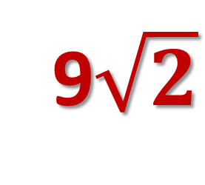
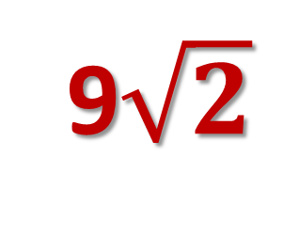
Example 2: Find the Missing Side.
$$x$$
9$\sqrt{2}$
9$\sqrt{2}$

Slide 5
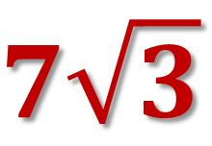


Example 3: Find the Missing Side.
$$45°$$
$$7\sqrt{3}$$
$$x$$

Slide 6

Example 4: Find the Missing Side.
$$45°$$
$$12$$
$$x$$

Slide 7


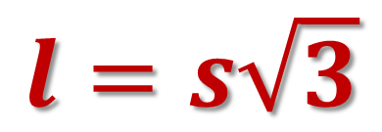

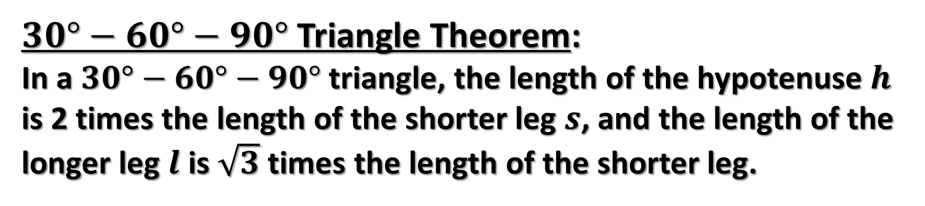
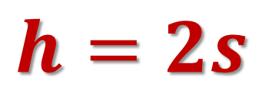
$30°−60°−90°$ Triangle Theorem:
In a $30°−60°−90°$ triangle, the length of the hypotenuse $h$ is 2 times the length of the shorter leg $s$, and the length of the longer leg $l$ is $\sqrt{3}$ times the length of the shorter leg.
$$60°$$
$$h=2s$$
$$s$$
$$30°$$
$$l=s\sqrt{3}$$

Slide 8





Example 5: Find the Missing Sides.
$$60°$$
$$8$$
$$x$$
$$30°$$
$$y$$

Slide 9

Example 6: Find the Missing Sides.
$$60°$$
$$10$$
$$x$$
$$30°$$
$$y$$

Slide 10


Example 7: Find the Missing Sides.
$$60°$$
$$h$$
$$x$$
$$30°$$
$$5$$

Slide 11



Example 8: Find the Missing Sides.
$$60°$$
$$h$$
$$21$$
$$30°$$
$$x$$

